Slide 1
The Public Health Registered Dental Hygienist
Presenters: Diane Alden, PHRDH & Deb Schardt, PHRDH
Guest: Cindy Gaskill, PHRDH
Notes:
Deb: Your introduction or greeting!
Diane: My introduction or greeting! A
Announce that Cindy is our guest
Cindy - Please, bow your head and take a moment to pray for care and healing during this unsettled time.

Slide 2
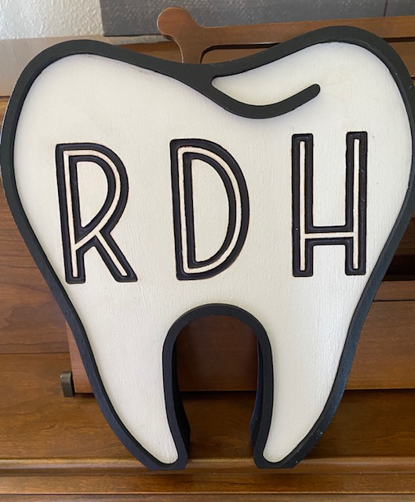
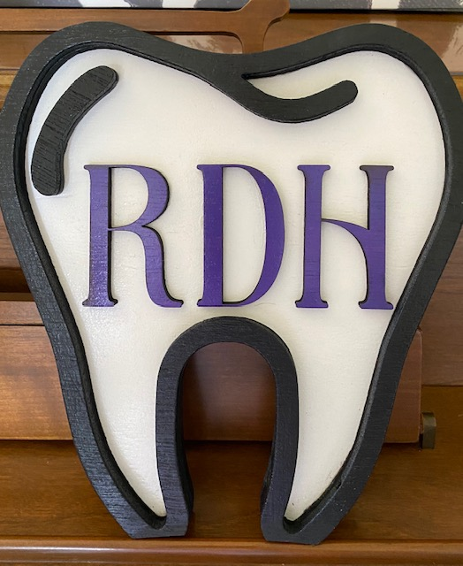
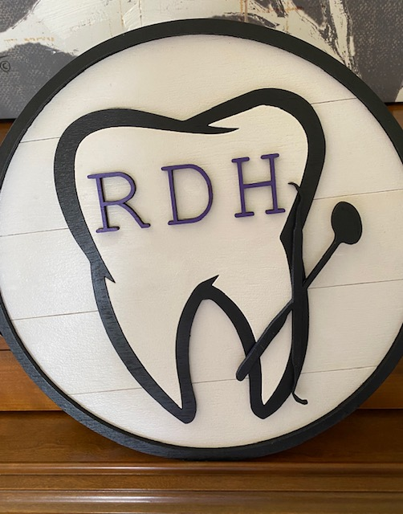
Time to Draw for Some Prizes!!
1
2
3
Notes:
Thank you, John Roberts our Executive Nebraska Dental Hygiene Director for setting this webinar up. We are praying we don’t have any glitches.
Thanks to Emilie Schardt for putting the slide presentation together. What we would do without our youth.
Special thanks to the following businesses; they generously gave some great door prizes.
Kaup’s Financial from Stuart, NE
Great Western Bank from Atkinson, NE
Kelcie Kohle with Stitch Sign from Stuart, NE
We have ten $10.00 Target Gift Cards.
We have three of the coolest RDH/Tooth signs made by Kelcie Kohle with Stitch Sign.
Let’s begin this CEU with a name drawn for a $10.00 Target Gift Card.
Congratulations:____________________________
That was too fun, let’s have a name for the first tooth sign.
Congratulations:_______________________________

Slide 3
Notes:
Diane: We are in scary and uncertain times!
The COVID-19 has exposed the many holes in our health care delivery and other social safety net systems.
As we shift focus to protecting the physical, emotional and financial health of our communities, we know the need for access to critical dental care has not gone away, if anything it has worsen. The need for the Public Health Registered Dental Hygienist will increase in demand.

Slide 4
Nebraska Dental Statistics:
63.9% of 3rd graders had decayed teeth in 2015-2016
Nearly 1/3 of Nebraskans have not had a dental visit in the last year
Over ½ of the 93 counties are in a dental shortage area
Emergency Room visits accounted for $10 million in total costs for dental conditions in 2016
1 in 2 American adults have gum disease
Medicare does not cover dental treatment for elderly clients, leaving over 60% not receiving necessary care because they can’t afford it
2018 public health services provided by NE Public Health Dental Hygienists tipped the scales at 100,598
40% of these services were reimbursable by Medicaid/MCNA
Notes:
Deb: The NDHA created a brochure that includes these stats and other important information. Contact Deb Schardt if you would like a copy.

Slide 5
Types of PHRDH:
The First Type of PHRDH is for Treating Children:
A PHRDH who holds a permit and has their own professional liability insurance can:
Provide oral prophylaxis to healthy children who do not need antibiotics
Apply recognized topical agents for the prevention of oral disease (Fluoride & Silver Diamine Fluoride and sealants)
Requirements:
Report annually the services performed on a form provided by the office of Oral Health. This form is mailed to the PHRDH; you must fill out form and return by mail
Tell the patient that your services are preventive, not complete dental diagnosis and care
Past reports can be found at http://dhhs.ne.gov/Pages/Dental-Reports.aspx
ANY RDH THAT HOLDS A LICENSE CAN APPLY
Notes:
Deb:
2008 Nebraska approved the Public Health Registered Dental Hygienist
There are two types of PHRDH permits

Slide 6
The Application:
DHHS.oralhealth@nebraska.gov
Go to Licensing & Regulations (located in the bar top of page)
On Line Services (left side) Licensing Homepage (first one)
Scroll Down to Professions & Occupations
Scroll Down to Dentistry (left side)
Dental Hygienist (middle)
Applications for all RDH Licenses are listed
PH for Children
You must print off application
Notes:
Cindy: The application hyperlink is included in the resource page at the end of our presentation.

Slide 7
What’s Needed on the Application?
With the application you MUST attach:
A copy of your Certificate of Liability Insurance (ACORD form)
If you are using the Certificate of Liability Insurance issued to your employer as proof of professional liability insurance coverage, you must also provide a letter from the insurance company that indicates the insurance policy covers the services you provide under the Public Health Authorization, without the supervision of a licensed dentist, (as described in Neb.Rev.Stat.38-1130(3)
There is NO CHARGE for this permit!
Notes:
Cindy I would encourage you to purchase your own liability insurance independent of your dental office for the best protection. ADHA offers policies through MERCER for about $70 per year, so it is very affordable.

Slide 8
THE SECOND TYPE OF PHRDH PERMIT: TREATING CHILDREN AND ADULTS
RDH, who hold a permit, has professional liability insurance and has practiced dental hygiene in a clinical setting for 3000 hours can do the following:
ON CHILDREN
Give prophylaxis to healthy children who do not need antibiotics
Apply recognized topical agents for the prevention of oral disease (Fluoride & Silver Diamine Fluoride and sealants)
ON ADULTS
Oral Prophylaxis
Pulp Vitality Testing
Apply recognized topical agents for the prevention of oral disease (Fluoride & Silver Diamine Fluoride and sealants)
Requirements:
Report annually the services performed on a form provided by the office of Oral Health. This form is mailed to the PHRDH each year; you must fill out form and return by mail
Tell patient that your services are preventive, not a complete dental diagnosis and care
Notes:
Diane:
The process for this application is the same for the PH children application. However you will just click on the Children & Adults link instead.
The hyperlink is located in the resources.

Slide 9
What’s Needed on the Application?
With the application you MUST attach:
An affidavit of clinical experience from your employing dentist
Proof of employment by submitting a copy of your W-2’s
OR a letter from your employer on their letterhead, stating the total number of hours worked during that time period
With the application you MUST attach:
a copy of your Certificate of Liability Insurance (ACORD form)
If you are using the Certificate of Liability Insurance issued to your employer as proof of professional liability insurance coverage, you must also provide a letter from the insurance company indicating that the insurance policy covers the services you provide under the Public Health Authorization, without the supervision of a licensed dentist,(as described in Neb.Rev.Stat.38-1130(3)
There is NO CHARGE for this permit!
Notes:
Diane

Slide 10
LB312
The Bill is waiting for final reading in the legislature. After the final reading it will go to the Governor for his signature and the law will take affect 3 months after Legislature adjourns.
Eliminates the 3000 hour requirement for the Public Health RDH to be able to apply for the permit to treat children and adults
Allows for the full scope of a dental hygienist, with the exception of:
Scale and root planing
Nitrous Oxide
Local Anesthesia
Notes:
DEB WILL TALK ABOUT LB312 (3000 Hours) and possibly make a slide with information
This bill has been on final reading agenda and is still there pending the return of the Legislative Session. This is the final step before going to the Governor for signature. Three months after the adjournment of the Legislature is when the law takes effect.
Even though this was a compromise with the scale and root planing, it is a step in the right direction. It will allow for debridement, taking x-rays, etc. (This will be important as we look ahead with Teledentistry.)
NDHA is still working to get the scale and root planning in and hopefully look into allowing general supervision with local anesthesia in the future.

Slide 11
Expanded Scope Function for Dental Hygienists:
Dental Hygienist can apply for the following expanded functions to be added to their dental hygiene license after completing an education course for each expanded scope function:
Interim Therapeutic Restorations
Write Prescriptions for Mouth Rinses and Fluoride Products
Monitor, Administration & Titrate Nitrous Oxide
Approved courses are given by a Commission on Dental Accreditation (CODA) accredited dental hygiene program
Dental Hygienists who hold a Public Health Authorization for Treating Children and are applying to have Interim Therapeutic Restoration and the ability to write Prescriptions for Mouth Rinses and Fluoride Products added to their dental hygiene license will have them added to their Public Health Authorization also
Notes:
Deb:
Students who are currently graduating from any NE DH school are being taught these additional scope functions and will have the ability to perform these functions upon licensure.

Slide 12
Expanded Scope Function for Dental Hygienists (continued):
A Dental Hygienist who holds a Public Health Authorization for treating Children and Adults and is applying to have the below expanded scope functions added to their dental hygiene license will also have them added to their Public Health Authorization:
Interim Therapeutic Restoration
Write Prescriptions for Mouth Rinses and Fluoride Products
Make Minor Denture Adjustment
Notes:
Cindy

Slide 13
The Application for Expanded Scope Functions:
DHHS.oralhealth@nebraska.gov
Go to Licensing & Regulations (located in the bar top of page)
On Line Services (left side) Licensing Homepage (first one)
Scroll Down to Professions & Occupations
Scroll Down to Dentistry (left side)
Dental Hygienist (middle)
Applications for all RDH Licenses are listed
Click on the Expanded Scope Function for Dental Hygienists
Notes:
Cindy
Again, the direct link is on the resource page.

Slide 14
The Application:
You must print off the application
Application fee is $10.00—for each time you add an expanded scope function(s) to your current license
(If you apply for all expanded scope functions at one time, it is only $10.00. If you apply for expanded scope functions at different times, you will have to pay $10.00 each time you add one on to your current license)
Provide Copy of the Following Document: (course should provide you with a document)
Name and location of institution where expanded function course was taken
Date of successful completion of the expanded function course
***The approved course needs to be provided by a Commission on Dental Accreditation (CODA) accredited dental hygiene or dental assisting program
Notes:
Diane:

Slide 15
Available Courses:
Central Community College Dental Hygiene in Hastings, Nebraska has offered three Expanded Scope Function classes for the Registered Dental Hygienist
75 Registered Dental Hygienists have successfully completed the course
The course was $500.00
Central Community College Dental Hygiene and others will be offering more classes
At this time, obviously no classes are being held
Notes:
Diane: Prizes

Slide 16
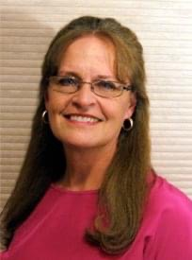
What are the Public Health Registered Dental Hygienists doing in Nebraska?!
Cynthia Carlson, PHRDH in Lincoln started working six years ago with an Alzheimer’s Care Facility, to provide hygiene care. She provides blood pressure check, oral cancer screening (intra/ oral), dental screening/assessment, prophy (scaling & polish), fluoride varnish, silver diamine fluoride and oral health education. Cynthia also provides education to the staff and referrals to a dental home. This has been very successful. COVID-19 has stopped this great program for the time being.
Cynthia has been very active as a PHRDH and these are a few of the many things that she has been involved in: conducted elementary school fluoride varnish and oral health education programs, applied fluoride varnish and dental screenings for a County Health Department, worked with WIC and Head Start programs, and provided CEU on what the PHRDH can provide for several nursing homes.
Notes:
Diane

Slide 17
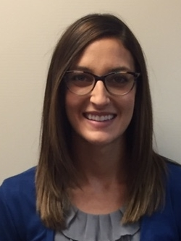
What are the Public Health Registered Dental Hygienists doing in Nebraska?!
Kerri Dittrich, PHRDH in Norfolk works with Elkhorn Logan Valley Public Health Department. She has started school programs in her area; she provides oral health dental screenings/assessments, oral cancer screenings (intra/oral), oral health education, dental sealants, fluoride varnish and silver diamine fluoride.
Kerri has also been in long term care facilities; she gave CEU to the staff (CNA’S, Med Aides & Nurses). For the residents she provides blood pressure checks, oral cancer screenings (intra/oral), dental screenings/assessments, prophy (scaling & polish), gross debridement, fluoride varnish, silver diamine fluoride and oral health education.
Kerri is currently working with dental providers, businesses, and the general public regarding COVID-19. She also helps with close contact interviews and risk assessment for individuals in her four county service area.
Notes:
Diane

Slide 18
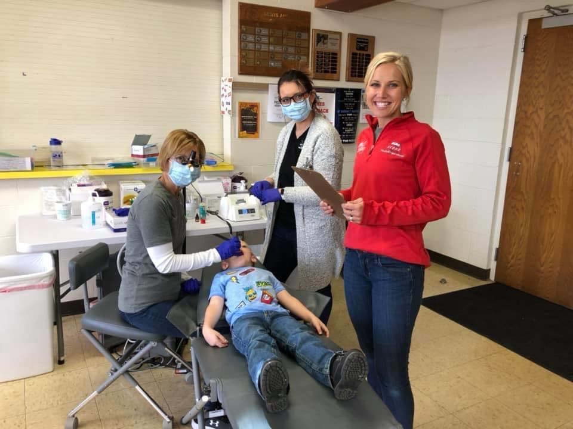
What are the Public Health Registered Dental Hygienists doing in Nebraska?!
Diane Alden PHRDH works with North Central District Health Department in O’Neill. She works with the Miles of Smiles program. They provide services to 38 schools in nine counties; cancer screening (intra/oral), dental screening/assessment, fluoride varnish, sealants and dental oral health education. She gives presentations to each classroom providing the teachers allow it. If there is no time for classroom education, she educates as she sees the students. She takes empty energy drink, soda, juice and milk bottles filled with the amount of sugar that each one contains. She is working on getting the silver diamine fluoride incorporated into the program.
Diane has been into several nursing homes and assisted livings in her nine county regions. She presented to all facilities on the importance or good oral health and what the PHRDH does. She was well received and encouraged to come back. Diane did blood pressure check, oral cancer screening (intra/oral), dental screening/assessment, prophy (scaling & polish), debridement, fluoride varnish, silver diamine fluoride and oral health education. She wrote up treatment plans for each resident and presented to the resident, facility and a family member. She referred residents to dental providers.
Diane wrote prescriptions for Chlorhexidine and Colgate Prevident 5000 and she provided denture adjustments and denture cleaning with her expanded scope function license.
Diane has seen and provided services to children and adults at WIC, Head Start, and Preschools.
The Miles of Smiles Program was awarded a grant from the Nebraska Community Foundation that needed matching funds. Diane went to her districts County Supervisors and Local Community Foundations and gave presentations on the importance of dental prevention; she requested funding and all contributed.
Notes:
Diane:
With all of the services that PHRDHs provide, it is very important to have consent forms signed by patient, parent or guardian (POA).

Slide 19
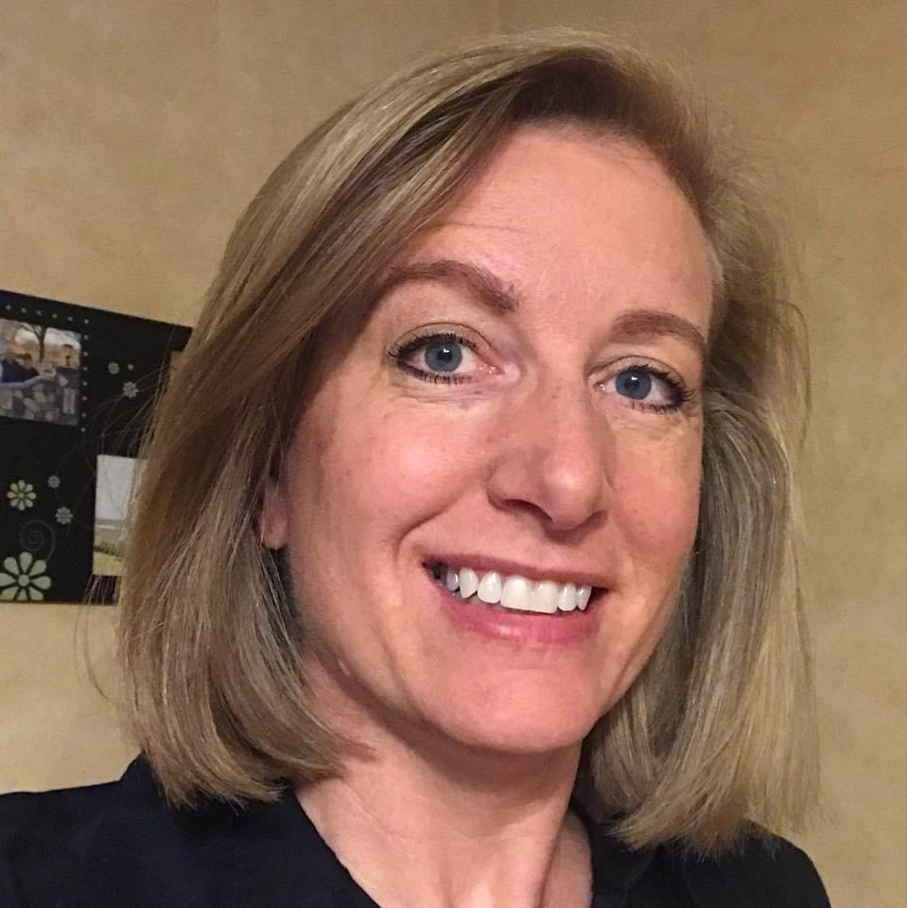
What are the Public Health Registered Dental Hygienists doing in Nebraska?!
Julie Niles, PHRDH works through Two Rivers Public Health Department, however the dental program was cut last February due to no funding. She has been in contact with the nursing home in Cozad a couple of times and they would like for her to continue there but without funding she hasn’t been back. When she was going to the nursing home she went weekly and completed brushing, flossing, fluoride, Oral Cancer Screening and applied SDF where indicated after getting a consent for treatment from the guardian. Prophy’s were done every 3-6 months as needed.
Julie stayed in close communication with each resident’s dentist. If she observed any concerns, Julie would notify the DDS and the staff at the nursing home. The local dentists were pleased with this arrangement that ensured the patients were getting the care that they needed.
Notes:
Deb

Slide 20
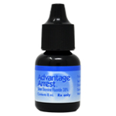
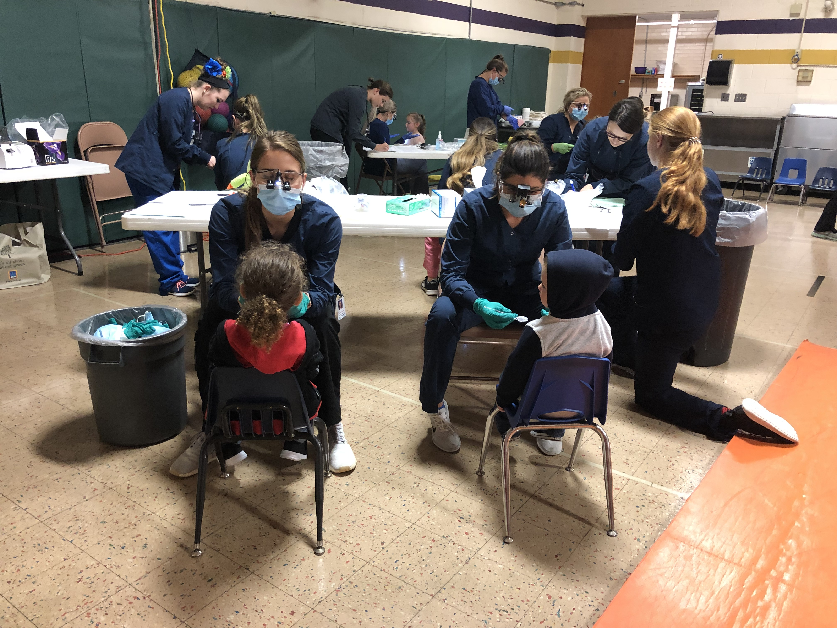
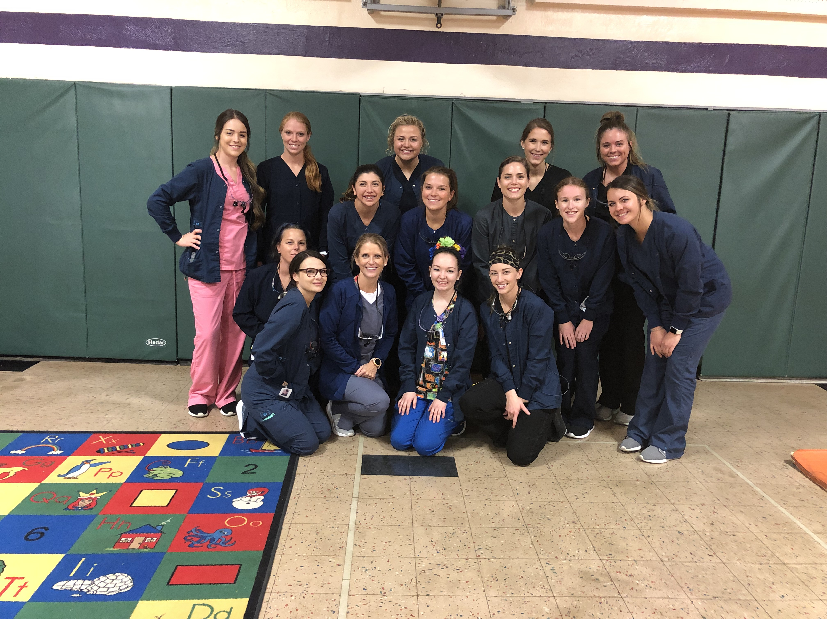
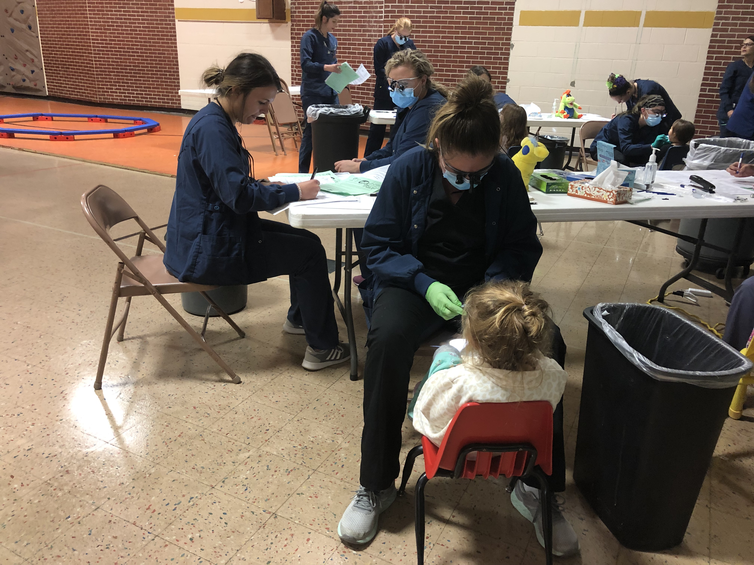
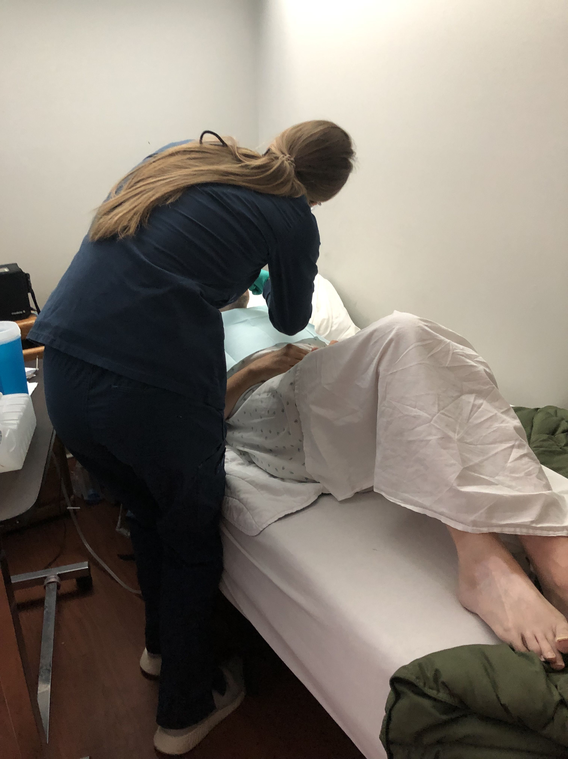
What are the Public Health Registered Dental Hygienists doing in Nebraska?!
Deb Schardt, PHRDH
Works at Central Community College in Hastings and Public Health Solutions Health Department in Crete serving 5 counties
Serves students in Head Start programs and local schools
Oversees CCC dental hygiene students during their public health rotations and provides Screenings; Fluoride Varnish; Glass Ionomer Sealants; and Silver Diamine Fluoride with parental consent
We have had great success with reduced urgent referrals. We do bill Medicaid directly as well as obtain some grant funding to keep the program at CCC sustainable
Notes:
Deb:
I serve students in Head Start programs and local schools through Central Community College in Hastings and Public Health Solutions District Health Dept. out of Crete. I oversee CCC dental hygiene students during their public health rotations and we provide Screenings; Fluoride Varnish; Glass Ionomer Sealants; and Silver Fluoride with parental consent. We have had great success with reduced urgent referrals. We do bill Medicaid directly as well as obtain some grant funding to keep the program at CCC sustainable.
Due to limited funding, the services have been limited through the Health Dept.
Also pictured is one of our nursing home rotations that Dr. Wanda Cloet supervises.
We have talked a lot about Silver Diamine Fluoride. For those of you who are not familiar with Silver Diamine Fluoride, it is an amazing product that is being used to help arrest decay.
Advantage Arrest™, the first silver diamine fluoride available in the USA, made in the USA.
Silver Diamine Fluoride has been used extensively around the globe for decades. Advantage Arrest silver diamine fluoride will change how you offer your patients the protection they deserve.
Advantage Arrest:
Provides immediate relief from dentinal hypersensitivity
Kills pathogenic organisms
Hardens softened dentin making it more acid and abrasion resistant
Does not stain sound dentin or enamel, but is does turn decay BLACK!! (And everything else it touches turns brown) So care is needed to be sure it is only getting on the tooth needing treatment
Silver diamine fluoride is indicated for the treatment of dentinal hypersensitivity, and off label to arrest decay. Advantage Arrest 8 mL bottles contains our new tinted blue formula for easy visualization during application and provides approximately 250 drops (enough to treat 1,250 sites, one drop treats 5 sites). And costs $179 per bottle. ($.72 per drop or about $.15 per site) Advantage Arrest is an FDA regulated prescription medical device and is only available for purchase and administration by a licensed healthcare professional.
SDF –There are some great CEU on the elevate oral care website that is on the resource page. Truly a game changer, especially in the times of COVID-19

Slide 21
Medicaid Reimbursement:
Currently, MCNA will reimburse for the following:
Prophy-- Adult D1110 (age 14 and older) ($33.66)
Prophy-- Child D1120 (age 13 and younger) ($26.52)
Fluoride Varnish D1206 ($20.40)
Dental Sealant D1351 ($25.50) covered on permanent and primary molars only – no premolars
Interim Caries Arresting Medicament Application (per tooth) D1354 ($10.20 per tooth) This would be for placing SDF
Notes:
Cindy:
encourage to bill what a dental office would instead of the Medicaid rate to encourage improved compensation in the future.
The Public Health RDH can apply Fl Varnish up to 4 times a year and it will not affect the services at a private dental office.
SDF can be billed every 180 days.

Slide 22
Medicaid Unreimbursed PHRDH Codes:
Currently, PHRDH can perform the following procedures, but MCNA will not reimburse a PHRDH at this time:
Protective Restoration This procedure may be used to relieve pain, promote healing, or prevent further deterioration D2940 ($32.64)
Full Mouth Debridement D4355 ($46.92)
Adjust Complete Denture Maxillary D5410 ($20.40)
Adjust Complete Denture Mandibular D5411 ($20.40)
Adjust Partial Denture Maxillary D5421 ($20.40)
Adjust Partial Denture Mandibular D5422 ($20.40)
These codes are billable codes that MCNA does reimburse dentists
Notes:
Cindy:
The protective restoration -. Examples are scoop and fill or ITR Interim Therapeutic Restorations
NDHA is working with our lobbyist and Senator Hansen to find a way to get these codes as well as some screening codes reimbursed for PHRDH

Slide 23
Codes NOT Recognized by MCNA
Screening of a Patient -- D0190
Assessment of a Patient -- D0191
Education/Oral Health Instructions -- D1330
Caries risk assessment-low risk -- D0601
Caries risk assessment-moderate risk -- D0602
Caries risk assessment-high risk -- D0603
As of 2017, 14 states reimbursed for the screening and assessment codes and 8 reimbursed for the caries risk assessments
Notes:
Deb: I have listed the approved procedures for the Nebraska Public Health Registered Dental Hygienist that are NOT billable through MCNA.
The expansion of approving the top two billable codes, the screening and assessment) would help children with dental disease to connect with a dentist for needed treatment and help nursing home residents and other adults with a dental disease to connect with a dentist for needed treatment.

Slide 24
Applying for Medicaid Reimbursement:
Step 1:
Get a NPI (National Provider Identifier) number.
Apply: https://nppes.cms.hhs.gov or call 800-465-3203
Step 2:
Get a Medicaid number
Apply: www.nebraskamedicaidproviderenrollment.com
Screening and Enrollment Requirements:
To complete provider enrollment or updates to existing provider agreements through Maximus, please visit: www.nebraskamedicaidproviderenrollment.com
Maximus Customer Service can be reached toll free at (844)-374-5022 or nebraskamedicaidPSE@maximus.com
Completed paper enrollment packets can be sent to the email address above or mailed to Maximus Nebraska Medicaid Provider Enrollment P.O. Box 81890 Lincoln, NE 68501
Notes:
Diane: Easy to get NPI number, how long it takes? After you get the NPI number then you can go to Step 2 to get the Medicaid number.

Slide 25
Additional Information:
You will have to create a Log In and Password
You will need a Tax ID Number or Social Security Number
You will need the extra four digits on the end of your zip code
You will need Bank Routing Number and Bank Account Number
(844)-374-5022 is the best resource and help. They will walk you through the entire application
You will be sent an email with your Medicaid Number
You will need the Medicaid Number to become a Managed Care of North America (MCNA) provider
Notes:
Diane:
This is a list of things you will want to have handy when filling out the application.

Slide 26
MCNA Provider Network Enrollment:
MCNA is the sole dental benefits administrator for Nebraska’s Dental Medicaid program.
http://www.mcnane.net
Step 1: Download and read the Welcome Letter
Step 2: Download and complete one New Provider Form
Step 3: Download and complete one New Location Form for each physical location
Step 4: Download and complete the Dental Provider Agreement which includes fee schedules
Step 5: Download and complete the IRS W-9 Form
Step 6: Download and complete the Payment Method Selection Form
Step 7: Fax the completed documents to 877-563-8560 or
Email them to ProviderEnrollment@MCNA.net or mail them to: MCNA Dental, Attn: Nebraska Network Development, P.O. Box 29008, San Antonio, TX 78229
If you need assistance, please contact Provider Services 844-353-6262
Notes:
Diane

Slide 27
Additional Information:
You can contact Nebraskapr@mcna.net and they answer quickly
New Provider Form, title is left blank if you are RDH/PHRDH
You must submit a copy of your Professional Liability Insurance
New Location Form can be your home if you are the provider and go into several facilities
You must submit a IRS W-9 Form
You must submit banking information and a voided check
Once you submit, a provider representative will contact you
It takes 2-4 weeks to get credentialing
Ricky Fletcher at rfletcher@mcna.net is a great contact for any questions you may have
Notes:
Diane

Slide 28
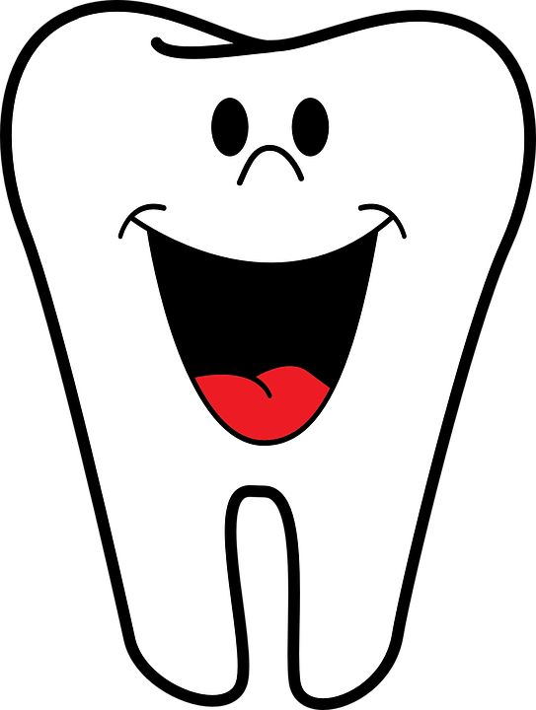
Barriers for PHRDH
Finding a dental home for patients on Medicaid/MCNA
Time it takes to treat a long term care patient
Low or No Reimbursement from Medicaid
Transporting equipment is challenging
Notes:
Deb
It is very challenging to find providers who will take Medicaid, especially NEW Medicaid patients. This will become even more difficult with Medicaid expansion.
PHRDH will play a vital role with the expanded scope and being able to place ITR for these patients. (SMART restorations) using SDF and glass ionomer restorations
With COVID-19 and moving forward, these types of restorations should be used more often as they do not produce an aerosol.
-_
Deb please add: there seems to be a disconnect between the PH Statutes and education of the dental community. Also - some reports of Dental Offices not being able to bill for permanent restorations after SDF was placed. Note: MCNA will not reimburse for a permanent restoration for 3 months from SDF date of service. MCNA’s has a great system to look up what services have been provided to every client enrolled. If you are a provider you can look this information up.

Slide 29
Resources:
Dental Hygienist Application page http://dhhs.ne.gov/licensure/Pages/Dental-Hygienist.aspx
PH application for treating children http://dhhs.ne.gov/licensure/Documents/DentHygAppForAuthToTreatChildren.pdf
PH application for treating children and adults http://dhhs.ne.gov/licensure/Documents/DentHygAppForAuthToTreatChildrenAndAdults.pdf
Expanded Scope Function http://dhhs.ne.gov/licensure/Documents/DentHygExpandedScopeApp.pdf
Nebraska Medicaid Practitioner Fee Schedule for 2020 http://dhhs.ne.gov/Medicaid%20Practitioner%20Fee%20Schedules/Dental%20Services%20January%201,%202020%20REVISED.pdf
Advantage Arrest SDF http://www.elevateoralcare.com
Notes:
Deb:
Here is the direct link for the applications we have covered. Also, there is a link for the current Dental Medicaid Fee Schedule. This usually changes annually in July, so you will want to make sure that you are utilizing the current schedule.
Our contact information is on the last slide – please don’t hesitate to contact either one of us with any questions now or in the future. This PowerPoint will be posted on the NDHA website after annual sesson.
Diane will do prizes –
Any questions?

Slide 30
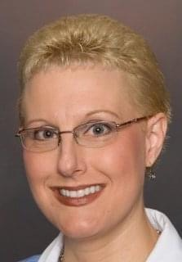
Presenters:
Diane Alden, RDH, PHRDH
Email dianealden@telebeep.com
Mobile: 402-340-5718
Deb Schardt, RDH, PHRDH
Email debschardt@icloud.com
Mobile: 402-310-4428
Notes:
Prizes!!!!!!!

